Slide 1
Client implementation of TLS https://github.com/JavaCardSpot-dev/smart_card_TLS
Project Members:
Sujeet Deshmukh(476359)
Nidhi Pokhriyal(476361)
Surendra Kumar Yadav(476364)

Slide 2
Extensible Authentication Protocol (EAP)
An authentication framework which supports multiple authentication methods.(RFC 3748)
EAP is a way for a supplicant to authenticate, usually against a back-end authentication server.
Runs directly over data link layers such as Point-to-Point Protocol (PPP) or IEEE 802, without requiring IP.

Slide 3
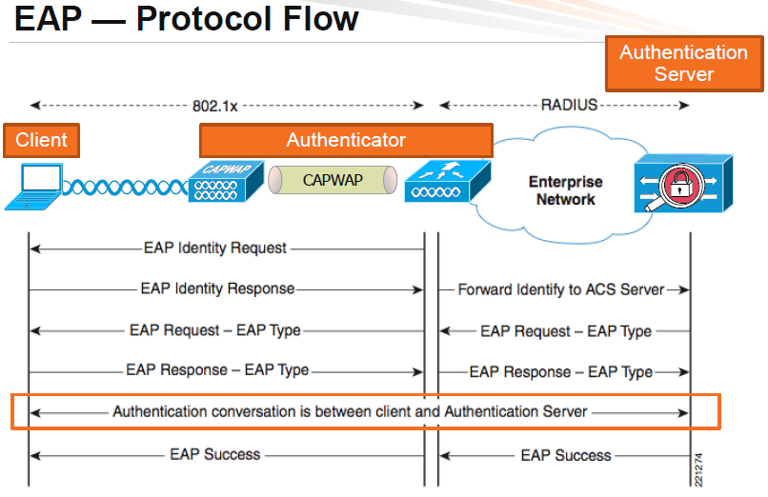

Slide 4
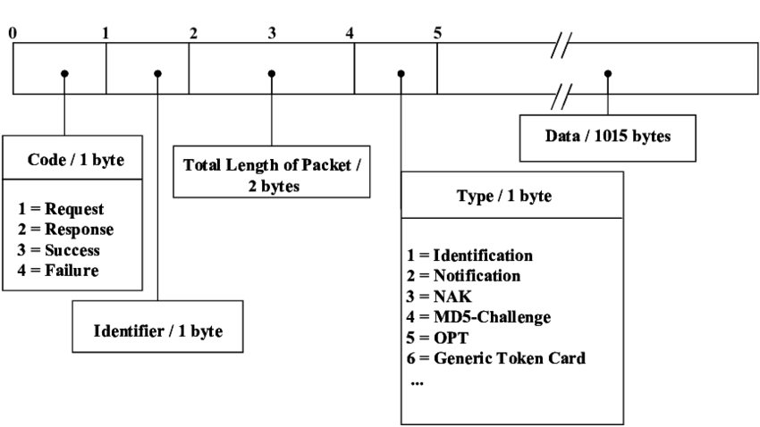
EAP Packet Format

Slide 5
EAP-TLS
In EAP-TLS, the SSL handshake is performed over EAP instead of TCP.
To implement EAP-TLS, both the server and client require a Digital Certificate for mutual authentication.
EAP-TLS message Format
EAP Code | EAP Identity | Length (2 Bytes) | EAP Type | FLAG LMSRRRRR | TLS Message Length(4 bytes) | TLS Data

Slide 6
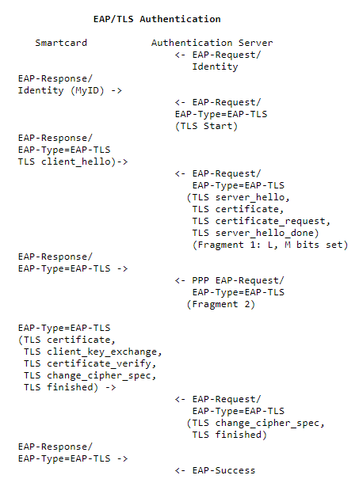

Slide 7
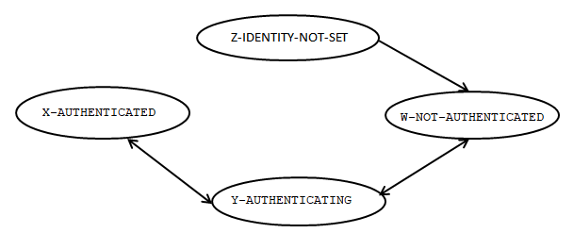
Smartcard EAP framework state machine sequence
Z-W : An available identity successfully set
W-Y : First Authentication Request received
Y-X : Authentication Successful.
X-Y : First Authentication Request received.
Y-W : Authentication Error.

Slide 8
CALL GRAPH
Install()
Initialise()
APDU
Select()
EAP
Pkt
APDU
EAP-TLS Pkt
process()
Process_EAP()
methodtls.process_eap()
EAP_IDENTITY
Client_Hello
Yes
EAP_START?
EAP_RESPONSE()
EAP Pkt
Client_finished
No
Yes
SERVER
HELLO?
Verify_PIN()
Change_PIN()
Get_current_identity()
Get_next_identity()
Set_identity()
Verify_server_pkt()
Change_cipher_spec()
No
EAP_Response
Yes
SERVER
FINISHED?
EAP_Response(failure)
No

Slide 9
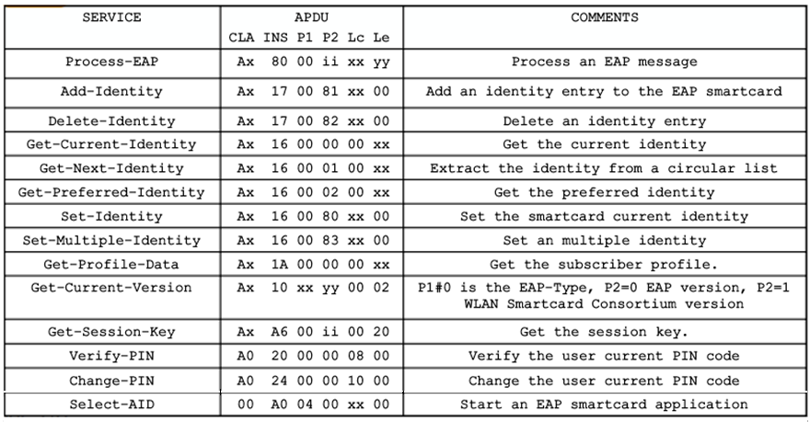
Command Summary

Slide 10
Issues Identified
Critical:
ISSUE#1: User PIN and Operator PIN are sent in clear hence its possible to snoop PIN
ISSUE#2: Key Block is also not cleared during RESET
ISSUE#3: Premaster and Master secret are not cleared during RESET
ISSUE#4: Heap is not cleared at RESET , just heap pointer is set back to offset 0
ISSUE#5: Buffer storing the application data is not cleared during RESET.
Moderate:
ISSUE#6: The User PIN cannot be changed because of wrong implementation of Change PIN function
Minor Issue:
ISSUE#7: Implementation of 8 byte PIN ; whereas only 4 bytes are taken from user and rest are hardcoded(0xFF)

Slide 11
Amendments in Code
ISSUE#1:
User PIN and Operator PIN were both sent in clear hence its possible to snoop PINs
Could be resolved by using symmetric keys at both ends.
Symmetric keys can be established using DH key exchange between client and server.
ISSUE#2: Resolved
Key block stores the keys derived from Master secret.
Key block was declared as byte array (EPROM) and was not cleared during RESET.
Key block now declared as transient array (RAM).
At each RESET Key block is wiped off by filling zeros.

Slide 12
Amendments in Code
ISSUE#3 :Resolved
Both Pre-master secret & Master secret generated were stored in byte arrays.
This byte arrays were not cleared during RESET.
Both Pre-master secret & Master secret are now stored in transient arrays.
At each RESET both secrets are wiped off by filling their arrays with zeros.

Slide 13
Amendments in Code
ISSUE#4: Resolved
Client random, server random and other important information is stored on heap.
Heap was declared as byte array and was not cleared during RESET.
At RESET, only heap pointer offset brought back to the start of heap.
Heap is now made a transient array.
At RESET Heap data is now wiped off by filling it with zeros.

Slide 14
Amendments in Code
ISSUE#5: Resolved
Application data was saved in a byte array record_buf.
Session resumption option is not used.
Even then application data of previous session was not cleared during RESET.
record_buf is now declared as transient array.
The application data is now wiped off by filling record_buf with zeros at each RESET

Slide 15
Amendments in Code
ISSUE#6: Resolved
Original code supported both four and eight byte long USER and OPERATOR PIN.
Implementation of verify() function did not allow change of USER PIN when it was only 4 byte long.
Verify function appends remaining four bytes which were hardcoded as 0xFF in case of user PIN.
Verify() function now accepts only eight bytes for both the PINs.
No part of USER PIN is hardcoded now.

Slide 16
Amendments in Code
ISSUE#7: Resolved
Implementation of 8 byte PIN ; whereas only 4 bytes are taken from user and rest are hardcoded(0xFF)
Changed verify() function now limits the user to use only 8 byte long PINs.

Slide 17
Testing
The PIN verification functionality was tested by sending test APDUs to the applet.
The PIN change function for both the PINs was tested.
EAP-TLS-START function was tested which responds with a default TLS_NAK message.
With EAP_Identity set, the response for EAP-TLS-START must be client random.

Slide 18
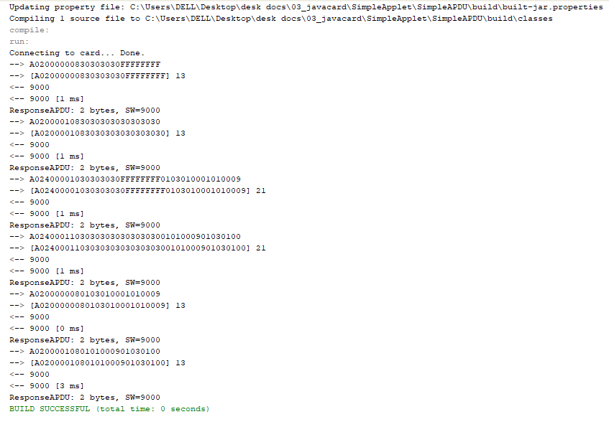

Slide 19
Phase IV
Performance measurements for following functions were tested using APDU logs
Performance measurements for following functions were tested by JCProfiler
Issue:-Change Operator PIN timings could not measured from JCProfiler
Report for the same Report-Phase IV.pdf
Function | Time
Verify User PIN | 34ms
Verify Operator PIN | 35ms
Change Operator PIN | 52ms
Change User PIN | 52ms
Function | Time
Verify User PIN | 22ms
Verify Operator PIN | 23ms
Change Operator PIN | *

Slide 20
Thank you for Your Attention !

